Slide 1
CSF 2113 Programming for Information Security
Fundamentals of File Handling
Muhammad Humayoun, PhD
Assistant Professor
mhumayoun@hct.ac.ae
Abu Dhabi Men’s College

Slide 2
I/O in Python: Reading a file
Python provides basic functions and methods necessary to manipulate files by default using a file object.
The open Function: Before you can read or write a file, you have to open it using Python's built-in open() function.
This function creates a file object, which would be utilized to call other support methods associated with it.
>>>file_object = open(file_name [, access_mode][, buffering])

Slide 3
file_object = open(file_name [, access_mode][, buffering])
file_name − The file_name argument is a string value that contains the name of the file that you want to access.
access_mode − The access_mode determines the mode in which the file has to be opened, i.e., read, write, append, etc. This is optional parameter and the default file access mode is read (r).
r: Opens a file for reading only. The file pointer is placed at the beginning of the file.
w: Opens a file for writing only. Overwrites the file if the file exists. If the file does not exist, creates a new file for writing.

Slide 4
I/O in Python: Reading a file
fobj = open("filename", "r")
The "r" is optional
Close it when finished working with the file
fobj.close()
access_mode:
Read: r
Write: w
Append:a
fobj = open("shakes.txt")
for line in fobj:
print(line.rstrip())
fobj.close()
Open shakes.txt file
Read file object fobj one line at a time
Print each line after stripping the whitespaces
Close the file object

Slide 5
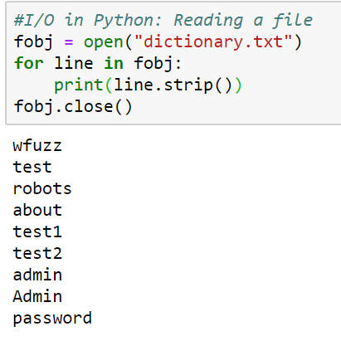
Reading a dictionary of passwords

Slide 6
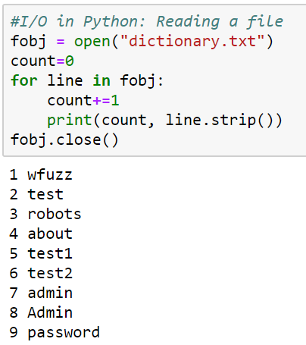
Activity: add line number with each line
# Reading a file
fobj = open("dictionary.txt")
for line in fobj:
print(line.strip())
fobj.close()

Slide 7
Reading in one go
Returns a list, convenient if the file is not too large
>>> text = open("dictionary.txt").readlines()
>>> print(text[:5])

Slide 8
Write into a File
fh = open("example.txt", "w")
fh.write("To write or not to write\nthat is the question!\n")
fh.close()
If the file example.txt already exits, it will be overwritten
To append an existing file use access mode “a”
fh = open("example.txt", "a")
fh.write("To write or not to write\nthat is the question!\n")
fh.close()

Slide 9
Activity: Reading and writing simultaneously
Read “dictionary.txt” line by line, add line number and then write it in a new file.

Slide 10
CSV: Comma Separated Values
CSV files are actually text files in which values are separated by comma
CSV is a simple file format used to store tabular data, such as a spreadsheet or database.
Files in the CSV format can be imported to and exported from programs that store data in tables, such as Microsoft Excel or OpenOffice Calc.

Slide 11
Reading records from a CSV file
SN | Name | City
1 | Michael | New Jersey
2 | Jack | California
3 | Donald | Texas
The records are represented as a text file:
SN, Name, City
1, Michael, New Jersey
2, Jack, California
3, Donald, Texas
We can read it the same way as you read a text file
fobj = open("name-city.csv")
for line in fobj:
print(line.strip())
fobj.close()

Slide 12
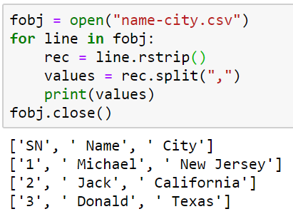
Processing the CSV further to extract a list of tuple
We want the file to convert into a list of tuple, where each tuple represents a record:
First attempt
[
(SN, Name, City)
(1, Michael, New Jersey),
(2, Jack, California),
(3, Donald, Texas)
]

Slide 13
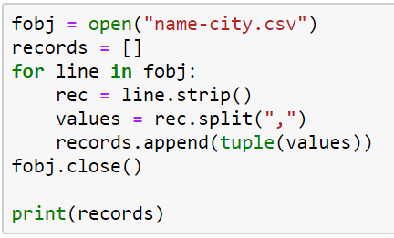
Processing the CSV further to extract a list of tuple
Final Attempt:

Slide 14
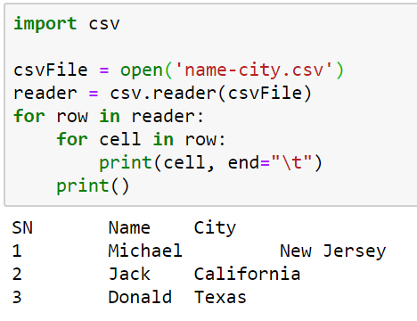
Using CSV library to read

Slide 15
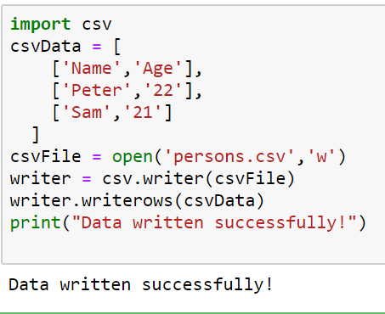
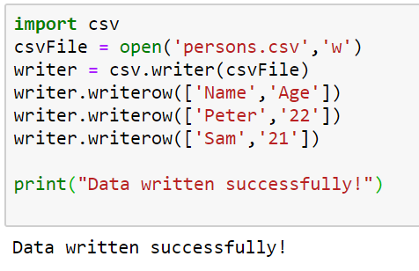
Using CSV file to write data

